Slide 1
Module 5 Routing Protocols
Dr PUNITHA K

Slide 2
Overview
Routing - Link State and Distance Vector Routing Protocols- Implémentation - Performance Analyses - Packet Tracer

Slide 3
Introduction
Routing is a process which is performed by layer 3 (or network layer) devices in order to deliver the packet by choosing an optimal path from one network to another.

Slide 4
Routing
Process of establishing the routes that data packets to reach the destination.
In this process, a routing table is created which contains information regarding routes which data packets follow.
Various routing algorithm are used for the purpose of deciding which route an incoming data packet needs to be transmitted on to reach destination efficiently.
Routing algorithm mathematically computes the best path, i.e. “least – cost path” that the packet can be routed through

Slide 5
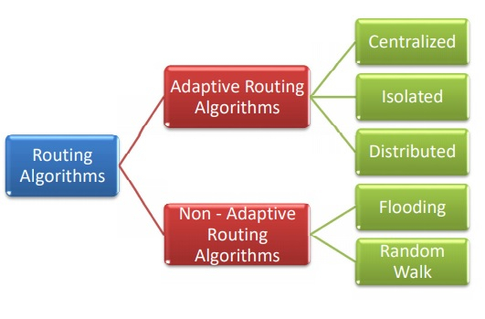
Types of Routing Algorithms

Slide 6
Adaptive Routing Algorithms
Dynamic routing algorithms, makes routing decisions dynamically depending on the network conditions.
Routing table is constructs depending on network traffic and topology.
Try to compute the optimized route depending upon the hop count, transit time and distance.
Types of adaptive routing algorithms are −
Centralized algorithm − finds the least-cost path between source and destination nodes by using global knowledge about the network. (Global routing algorithm)
Isolated algorithm − procures routing information by using local information instead of gathering information from other nodes.
Distributed algorithm − decentralized algorithm that computes the least-cost path between source and destination iteratively in a distributed manner.

Slide 7
Non – Adaptive Routing Algorithms
Static routing algorithms, construct a static routing table to determine the path through which packets are to be sent.
Static routing table is constructed based upon the routing information stored in the routers when the network is booted up.
Types of non – adaptive routing algorithms are −
Flooding − when a data packet arrives at a router, it is sent to all the outgoing links except the one it has arrived on. Flooding may be uncontrolled, controlled or selective flooding.
Random walks (probabilistic algorithm) where a data packet is sent by the router to any one of its neighbors randomly.

Slide 8
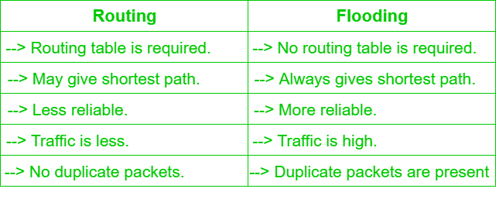
Routing v/s Flooding

Slide 9
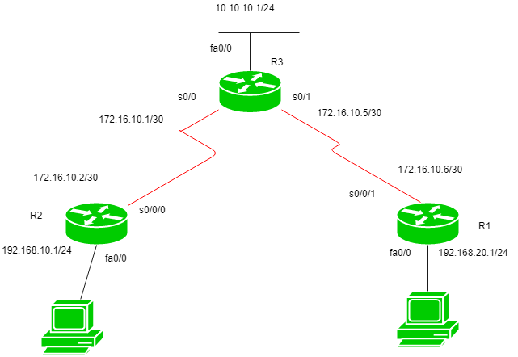
Configuration

Slide 10
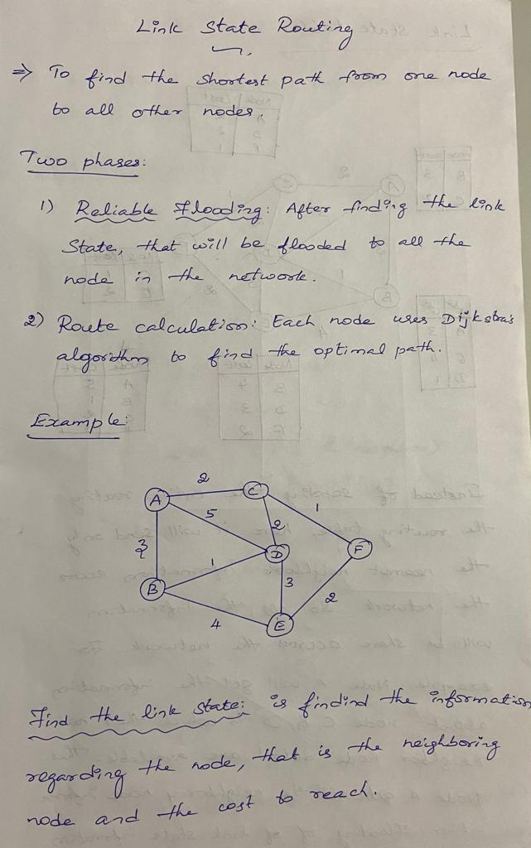

Slide 12
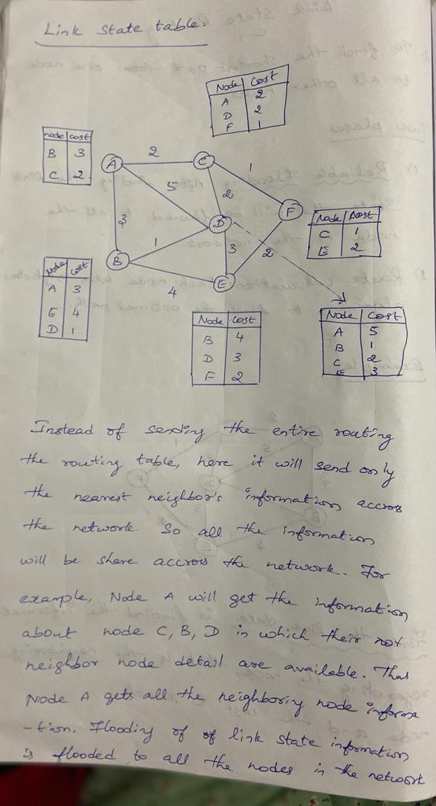


Slide 14
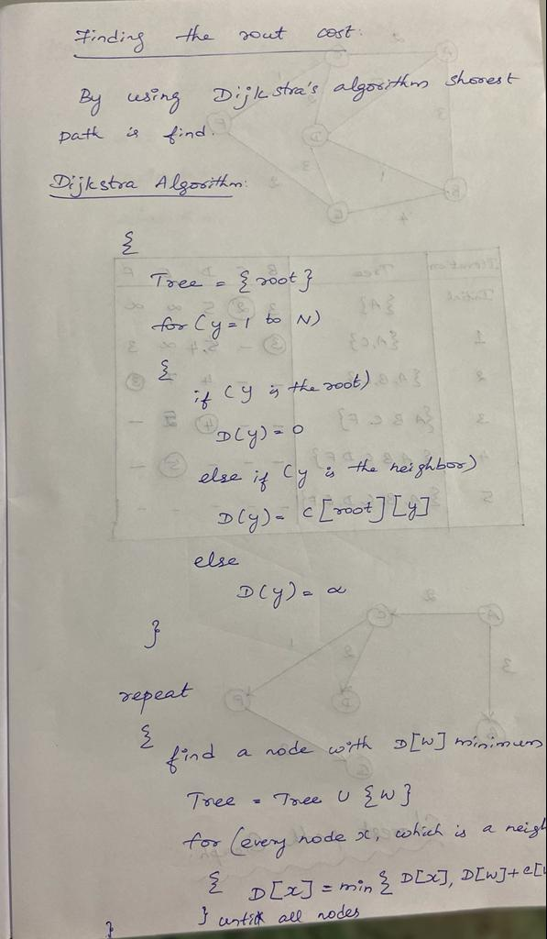

Slide 16
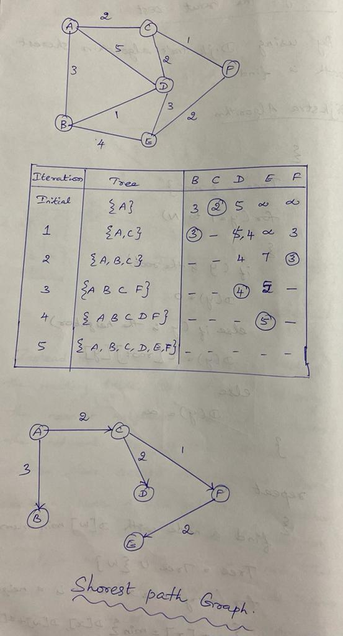

Slide 18
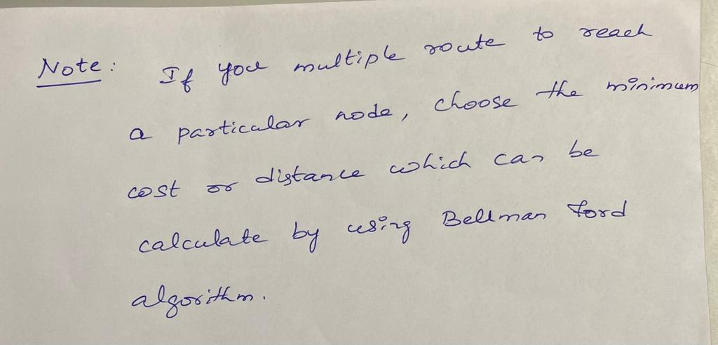
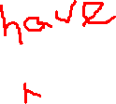

Slide 19
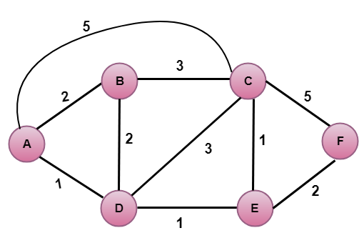
Practice problem

Slide 20
Distance Vector Routing Algorithm
Distance vector algorithm is iterative, asynchronous and distributed.
Distributed: It is distributed in that each node receives information from one or more of its directly attached neighbors, performs calculation and then distributes the result back to its neighbors.
Iterative: It is iterative in that its process continues until no more information is available to be exchanged between neighbors.
Asynchronous: It does not require that all of its nodes operate in the lock step with each other.
The Distance vector algorithm is a dynamic algorithm.
It is mainly used in ARPANET, and RIP.
Each router maintains a distance table known as Vector.

Slide 21
Three Keys to understand the working of Distance Vector Routing Algorithm
Knowledge about the whole network: Each router shares its knowledge through the entire network. The Router sends its collected knowledge about the network to its neighbors.
Routing only to neighbors: The router sends its knowledge about the network to only those routers which have direct links. The information is received by the router and uses the information to update its own routing table.
Information sharing at regular intervals: Within 30 seconds, the router sends the information to the neighboring routers.

Slide 22
Distance Vector Routing Algorithm
Let d_{x}(y) be the cost of the least-cost path from node x to node y. The least costs are related by Bellman-Ford equation,
d_{x}(y) = min_{v}{c(x,v) + d_{v}(y)}
Where the minv is the equation taken for all x neighbors. After traveling from x to v, if we consider the least-cost path from v to y, the path cost will be c(x,v)+d_{v}(y). The least cost from x to y is the minimum of c(x,v)+d_{v}(y) taken over all neighbors.

Slide 23
Distance Vector Routing Algorithm
A router transmits its distance vector to each of its neighbors in a routing packet.
Each router receives and saves the most recently received distance vector from each of its neighbors.
A router recalculates its distance vector when:
It receives a distance vector from a neighbor containing different information than before.
It discovers that a link to a neighbor has gone down.

Slide 24
DV calculation is based on minimizing the cost to each destination
Dx(y) = Estimate of least cost from x to y
C(x,v) = Node x knows cost to each neighbor v
Dx = [Dx(y):y ∈ N] = Node x maintains distance vector Node x also maintains its neighbors' distance vectors – For each neighbor v, x maintains Dv = [Dv(y): y ∈ N]

Slide 25
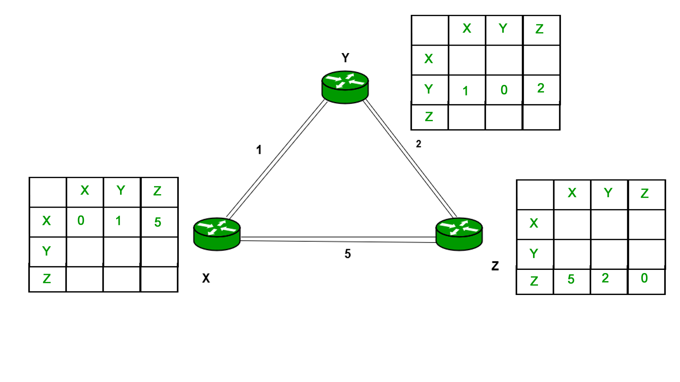
Consider 3-routers X, Y and Z as shown in figure. Each router have their routing table. Every routing table will contain distance to the destination nodes

Slide 26
Consider router X , X will share it routing table to neighbors and neighbors will share it routing table to it to X and distance from node X to destination will be calculated using bellmen- ford equation.
Dx(y) = min { C(x,v) + Dv(y)} for each node y ∈ N
As we can see that distance will be less going from X to Z when Y is intermediate node(hop) so it will be update in routing table X.

Slide 27
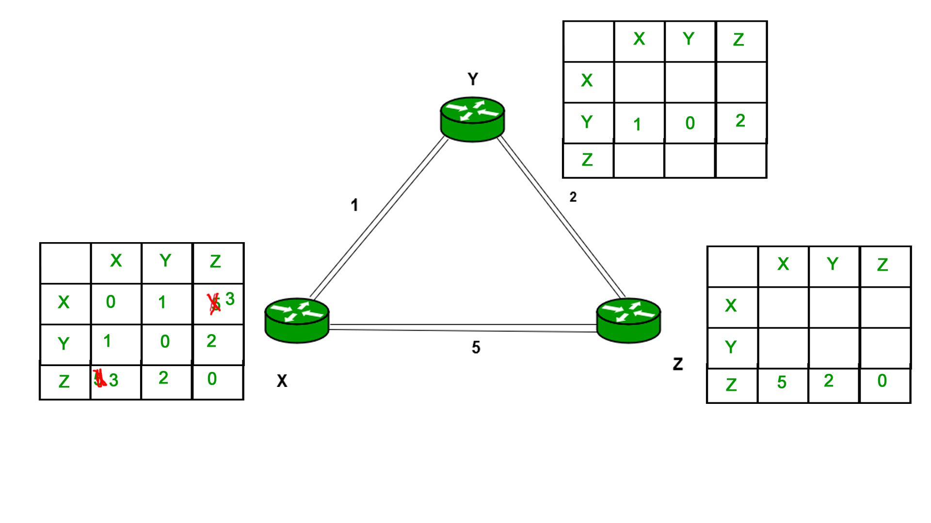
Similarly for Z also

Slide 28
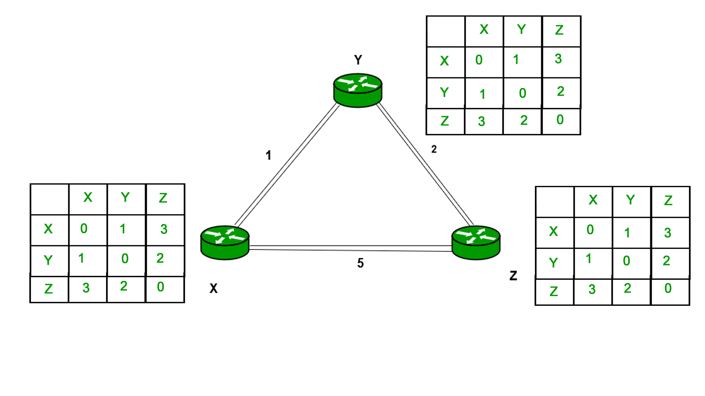
Finally the routing table for all

Slide 29
Advantages of Distance Vector routing
It is simpler to configure and maintain than link state routing

Slide 30
Disadvantages of Distance Vector routing
It is slower to converge than link state.
It is at risk from the count-to-infinity problem.
It creates more traffic than link state since a hop count change must be propagated to all routers and processed on each router. Hop count updates take place on a periodic basis, even if there are no changes in the network topology, so bandwidth-wasting broadcasts still occur.
For larger networks, distance vector routing results in larger routing tables than link state since each router must know about all other routers. This can also lead to congestion on WAN links

Slide 31
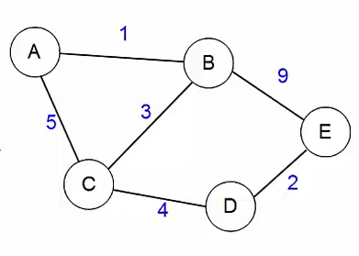
Practice Problem

Slide 32
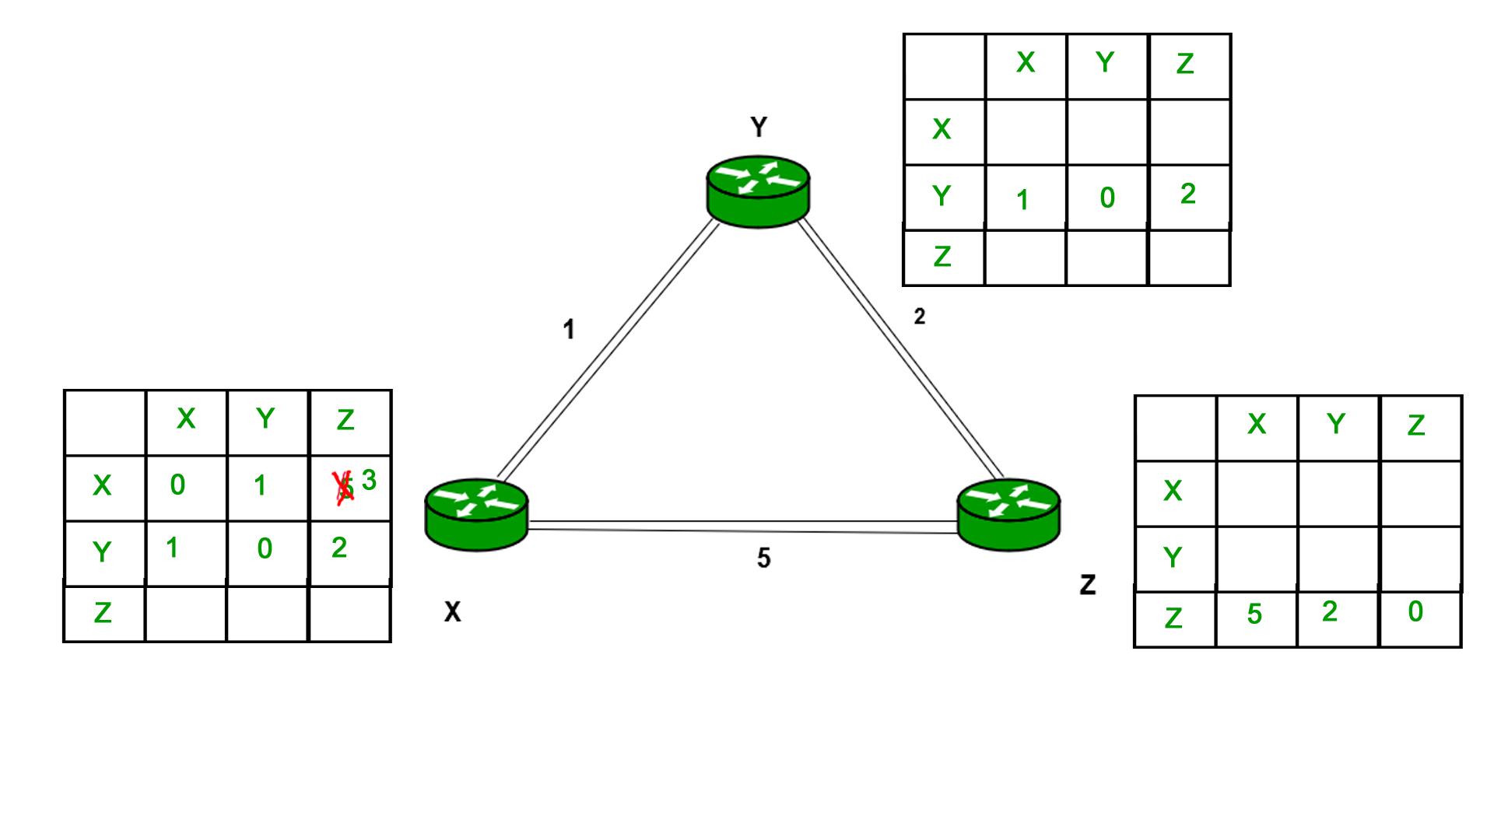

Slide 33
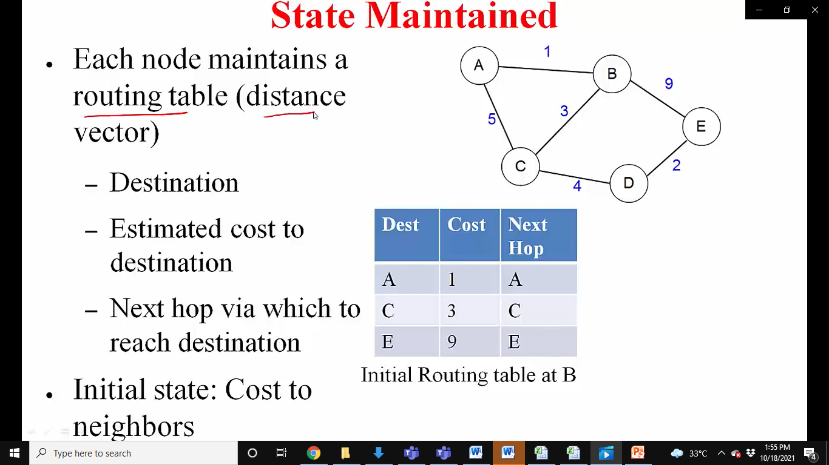

Slide 34
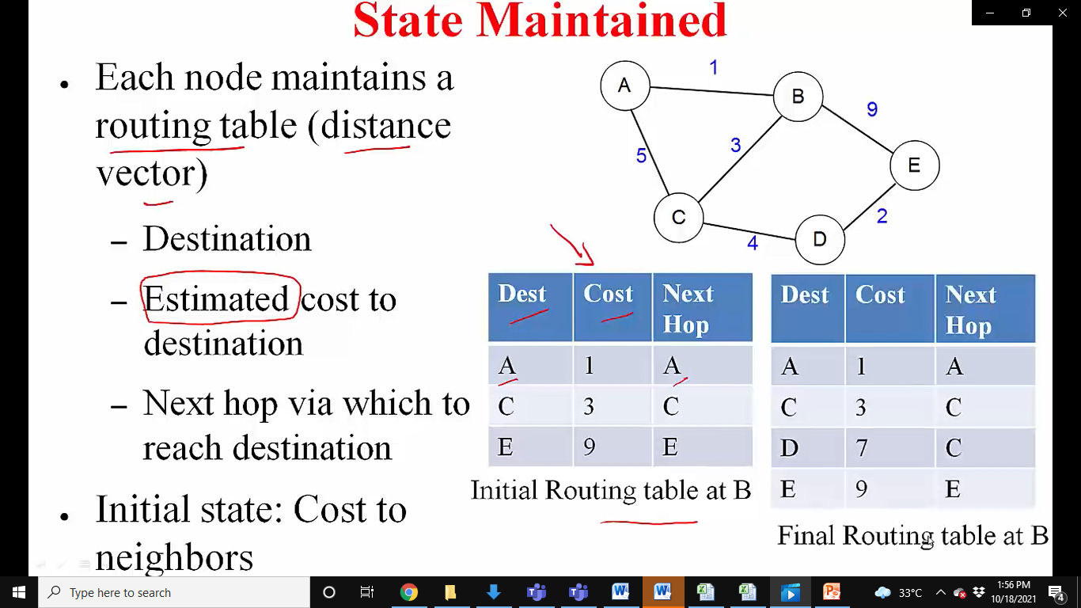

Slide 35
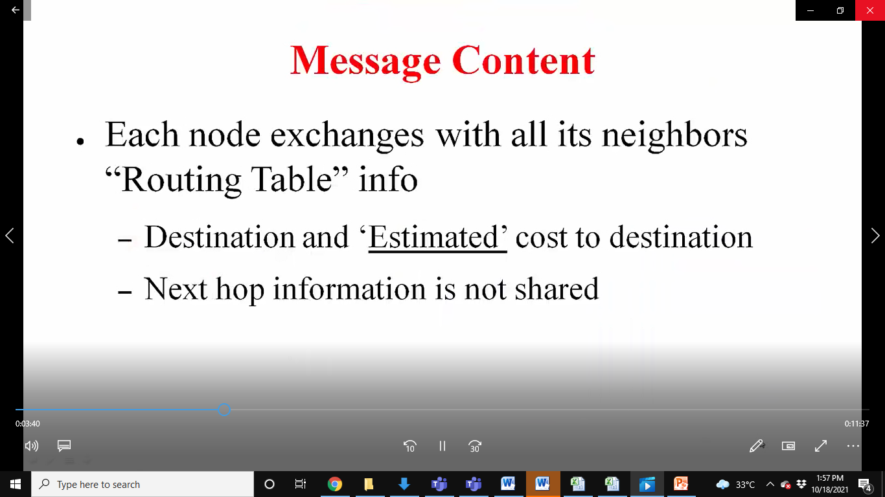
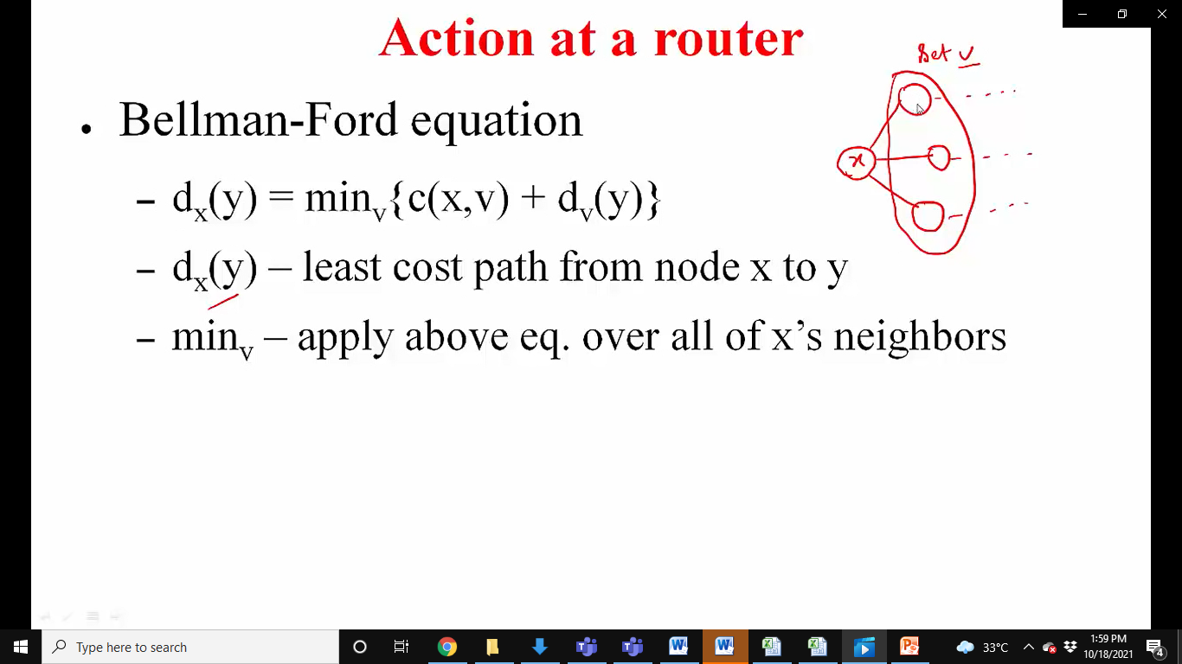

Slide 36
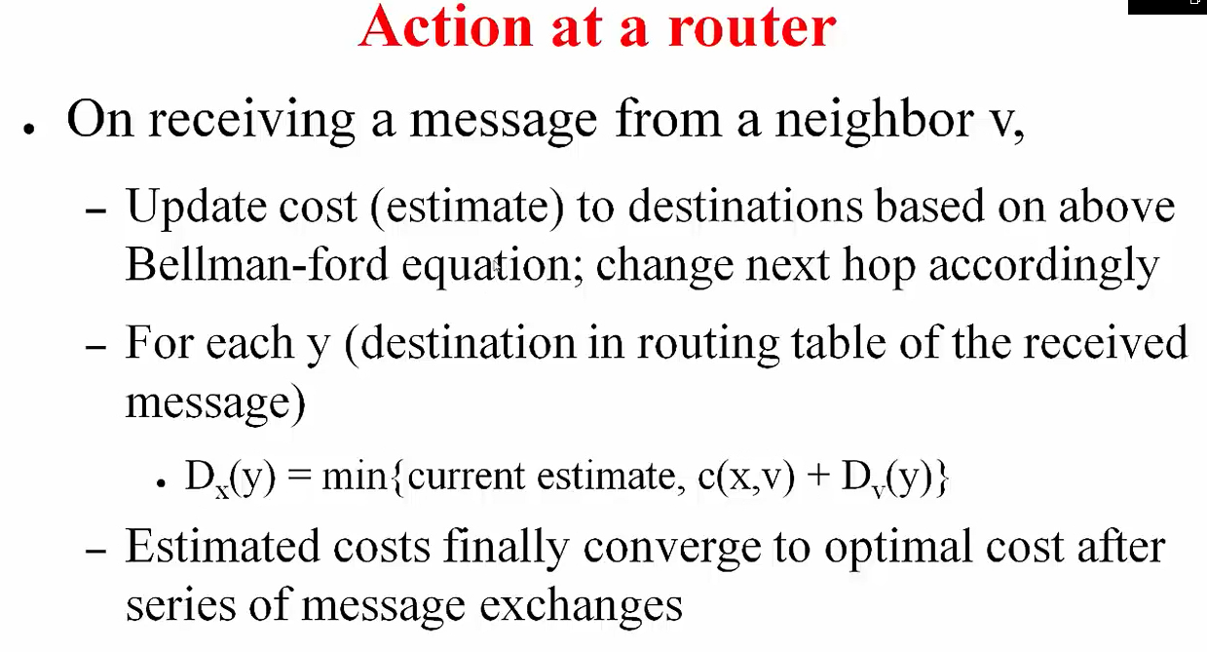

Slide 37
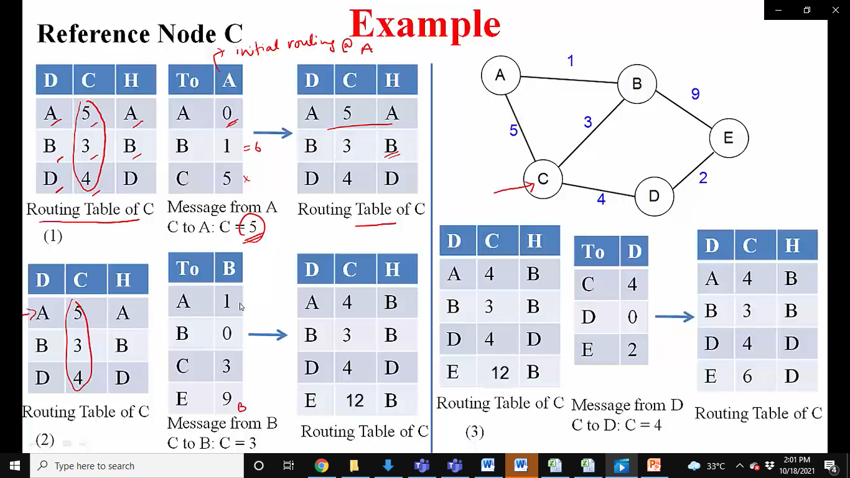

Slide 38
